Slide 1
IB Language A: Literature
Jacqueline Keeler

Slide 2
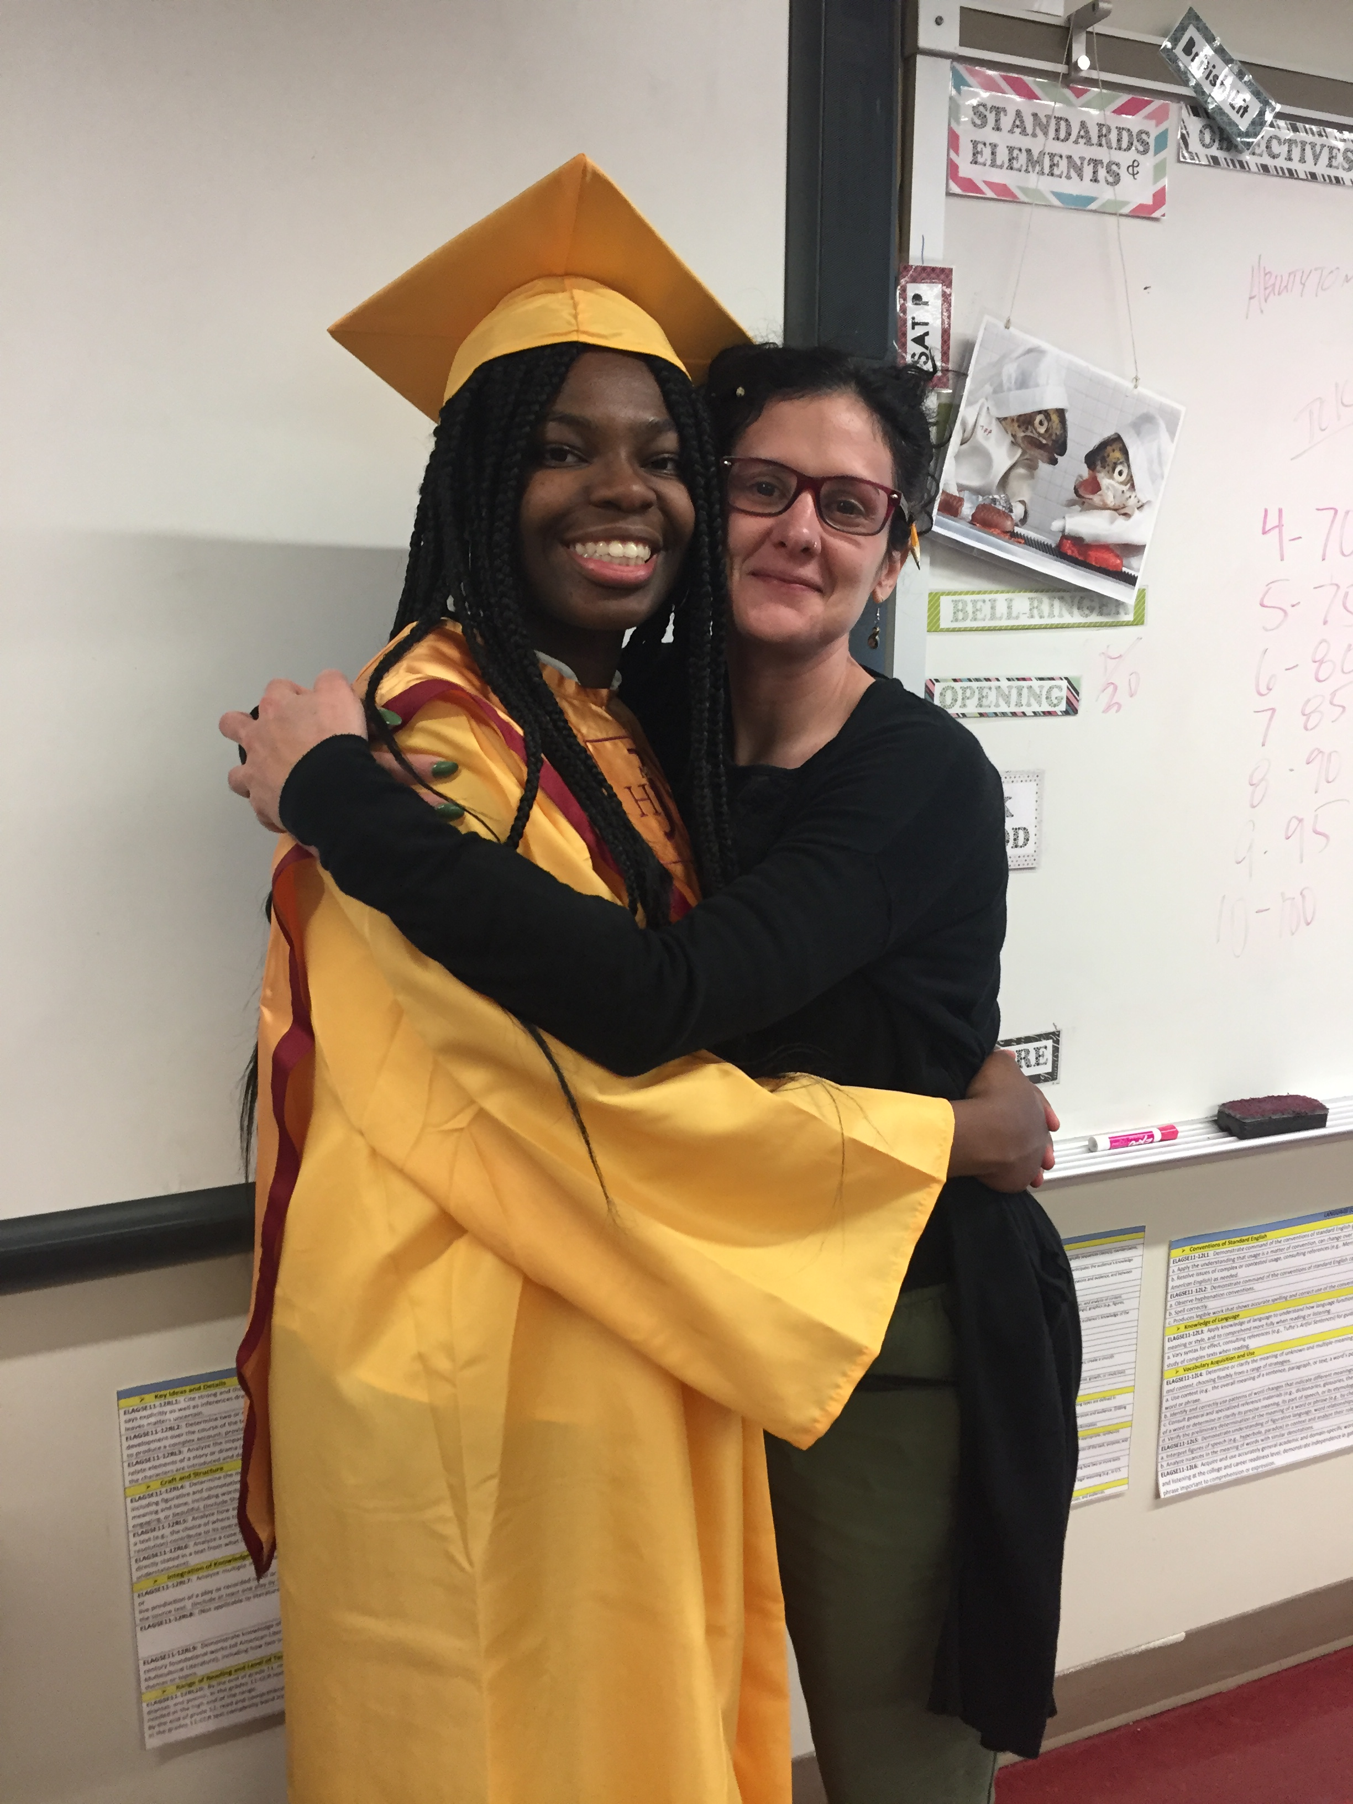
About Me
I have been teaching at Jackson for 18 years.
This is my sixth year teaching HL IB Literature, but my first year with the new curriculum. I am really excited about the changes and think the new course design is an improvement for our students.
I also teach Y2 TOK and I am the EE Coordinator.
I am from both North and South Carolina.
I attended College of Charleston and The Citadel (not the military part).
I have one son, Asa, who attends Burgess Peterson Academy.
I live in Clarkston right now and love it!

Slide 3
Tech Codes
Google Classroom
Code: rhwamsl
(Please do not drop last year’s class.)
My Website
https://www.msjkeeler.com/401/login.php?redirect=/ib-literature-new-curriculum.html password: Iheartreading
www.turnitin.com
code: 28542953 key: Literature
Managebac
https://jacksonib.managebac.com/login
Kami
You will need to download the Chrome extension.

Slide 4
Description (from the Guide)
The course is “designed for students from a wide variety of linguistic and cultural backgrounds who have experience of using the language of the course in an educational context.”
The language profile of students taking these courses will vary, but their receptive, productive and interactive skills should be strong and the expectation is that the course will consolidate them further.
Students are expected to develop their proficiency, fluency and linguistic range, and in particular to acquire the vocabulary appropriate to the analysis of texts. They will also deepen their understanding of a wide variety of concepts explored through literary and non-literary texts in order to interpret, analyze, evaluate and then communicate this understanding in clear, organized and developed products.
All three courses explore elements of language, literature and performance and focus on:
• the relationships between readers, writers and texts
• the range and functions of texts across geographical space and historical time
• aspects of intertextuality.
Students will focus exclusively on literary texts, adopting a variety of approaches to textual criticism. Students explore the nature of literature, the aesthetic function of literary language and textuality, and the relationship between literature and the world.

Slide 5
Aims and Assessments

Slide 6
Aims
The aims of all subjects in studies in language and literature are to enable students to:
engage with a range of texts, in a variety of media and forms, from different periods, styles, and cultures
develop skills in listening, speaking, reading, writing, viewing, presenting and performing
develop skills in interpretation, analysis and evaluation
develop sensitivity to the formal and aesthetic qualities of texts and an appreciation of how they contribute to diverse responses and open up multiple meaning
develop an understanding of relationships between texts and a variety of perspectives, cultural contexts, and local and global issues, and an appreciation of how they contribute to diverse responses and open up multiple meaning
develop an understanding of the relationships between studies in language and literature and other disciplines
communicate and collaborate in a confident and creative way
foster a lifelong interest in and enjoyment of language and literature.

Slide 7
Logistics
This is a two-year course.
The reading workload of primary texts will be broken into 6 texts the first year and 7 the second. These texts meet the requirements of the course as outlined by IB.
The course is structured with three spiraling Areas of Exploration—each requiring 80 hours of teaching. These units are not finite but are woven throughout the course. I will outline each on a later slide.
We will also take into consideration concepts and Global Issues for each text.
You will be required to keep a learner portfolio that will be compiled throughout the course. It will be a record of your work as well as a record of your understanding to use for later assessments. You will place a copy of each facet in Managebac.
You have four IB assessments. I will go into more details on a subsequent slide.
3 will be external
1 will be internal

Slide 8
Assessment Objectives
1. Know, understand and interpret:
a range of texts, works and/or performances, and their meanings and implications
contexts in which texts are written and/or received
elements of literary, stylistic, rhetorical, visual and/or performance craft
features of particular text types and literary forms.
2. Analyze and evaluate:
ways in which the use of language creates meaning
uses and effects of literary, stylistic, rhetorical, visual or theatrical techniques
relationships among different texts
ways in which texts may offer perspectives on human concerns.
3. Communicate
ideas in clear, logical and persuasive ways
in a range of styles, registers and for a variety of purposes and situations

Slide 9
Your IB Assessments
Cohort 2022:
Paper One will be 50%, the HL essay will be 25%, and the IO will be 25%
Paper 1 and Paper 2 will be at the end of the course for your IB Exams. You may use any text not previously used for an IB Assessment.
The HL Essay will occur either at the end of the junior year or beginning of senior year.
The IO will take place at the beginning of your senior year. It will primarily be based on texts from the junior year.

Slide 10
Your Class Assessments
The IB Grading Breakdown is as follows:
40% for summative assignments such as major essays, tests, and major projects
35% for formative quizzes and smaller projects
25% for smaller formative assignments such as daily practice/minor homework
You will rarely see a multiple choice test in this class. Almost every major assignment will be an essay or written exam. You will have oral exams as well.
Entries into the Learner Portfolio are mandatory for the course and for your work to be authenticated for submission.
You are expected to use Turnitin.com unless otherwise notified.
I will grant one amnesty day for missing assignments. It is my expectation that you will meet deadlines in this course so that I can best help you grow. We are humans, so if you have an emergency situation arise, please contact me and I will work with you to extend a deadline.

Slide 11
Your Class Assessments
Your attendance and participation are paramount to your success in this course. A failure to attend meetings/classes may lower your grade.
We will follow the APS guidelines for student attendance.
For other assignments, rubrics are posted on my website: www.msjkeeler.com. There is a class rubric for discussions that will be utilized during our daily meetings.
A daily calendar that includes instruction and independent practice is posted in Mangebac. Please consult this calendar.

Slide 12
Academic Honesty
Although more specific policy information will follow from Mr. King in a Google form, I want to emphasize that academic honesty is paramount to your success. If you are not practicing academic honesty by reading and completing assignments to the best of your ability, you will gain nothing from this course. I cannot help you grow as a writer and reader if you do not practice it.
We follow the APS district guidelines for academic dishonesty.
You must cite your sources at all times. Our standard format is MLA, which was specifically taught to you in the 9th and 10th grade. It is an expectation that you use parenthetical citations and a Works Cited at all times.
If you need help with MLA, please see my website www.msjkeeler.com and I have linked some resources. I am also available for help during tutorial times.
My best advice is to read and try your best. I can help a weak student. I cannot help a duplicitous one.

Slide 13
Areas of Exploration
The following will be woven throughout the course. The corresponding questions will be asked and answered throughout our study.

Slide 14
Readers, Writers, and Texts
This is a look in the nature of literature and its study. It will focus on key features of literary technique and formal study of how those techniques create meaning. It will also focus on the balance of the personal and academic response to literature. Questions addressed include:
Why and how do we study literature?
How are we affected by literary texts in various ways?
In what ways is meaning constructed, negotiated, expressed and interpreted?
How does language use vary among literary forms?
How does the structure or style of a literary text affect meaning?
How do literary texts offer insights and challenges?

Slide 15
Time and Space
This area looks at the cultural and contextual elements of literature. It asks us to evaluate works based on historical and cultural conditions of their setting, creation, publication, and how we as readers can relate. Questions addressed include:
How important is cultural or historical context to the production and reception of a literary text?
How do we approach literary texts from different times and cultures to our own?
To what extent do literary texts offer insight into another culture?
How does the meaning and impact of a literary text change over time?
How do literary texts reflect, represent or form a part of cultural practices?
How does language represent social distinctions and identities?

Slide 16
Intertextuality
This area of exploration asks us to see the connections among various pieces of literature, traditions, creators, or ideas. Questions addressed include:
How do literary texts adhere to and deviate from conventions associated with literary forms?
How do conventions and systems of reference evolve over time?
In what ways can diverse literary texts share points of similarity?
How valid is the notion of a “classic” literary text?
How can literary texts offer multiple perspectives of a single issue, topic or theme?
In what ways can comparison and interpretation be transformative?

Slide 17
Central Concepts
These concepts will also be explored throughout the course.

Slide 18
Identity
This concept explores the identity of the author vs those of his or her characters. What differences exist?
It also looks at the identity of the reader and how that identity shapes his or her analysis of the text.

Slide 19
Culture
This concepts asks students to look at the cultural context of when the book was written and published.
It asks them to analyze the impact of the literary tradition preceding the text.
It also asks students to examine their own cultures in their responses to the literature.

Slide 20
Creativity
This concept asks what role the imagination plays into the production, reception, and understanding of texts.
It asks students to go beyond existing literary criticism in order to establish their own meanings.

Slide 21
Communication
This concept asks how writers establish communication between themselves and their audiences with their choice of style and structure.
It asks what assumptions an author has made about his or her audience’s knowledge, values, and assumptions.
It pushes students to see that meaning is not static when approaching literature.

Slide 22
Perspective
This asks the students to analyze how an author’s perspective is reflected in his or her work.
It also pushes them to see the multiplicity of perspectives in the texts apart from their own.
Finally, it asks what role the reader’s perspective plays in evaluating literature and how literature itself has perhaps formed that perspective.

Slide 23
Transformation
This looks at intertextuality, as texts often harken to one another in subject matter, form, or meaning.
Students will also look at the act of reading as transformative in itself.

Slide 24
Representation
This looks at literature as a reflection of reality.
To what extent can it or should it do so?

Slide 25
Global Issues

Slide 26
Global Issues
Global Issues will be dealt with throughout the course in reference to each text we study; however, they will be especially paramount when we get to the IO. Essentially, students are asked to
Examine the ways in which the global issue of your choice is presented through the content and form of two of the works that you have studied.
The answer to the above prompt is directly pulled from prompts, notes, and discussions present in the Learner Portfolio.
In determining a Global Issue (and there is more on this on another presentation) students must find something that
Is significant on a large/wide scale
Is transnational
Is felt everyday in local contexts.
They are found within Fields of Inquiry that the IB has outlined and thus follow.

Slide 27
Culture, Identity, Community
Students might focus on the way in which works explore aspects of family, class, race, ethnicity, nationality, religion, gender and sexuality, and the way these impact on individuals and societies. They might also focus on issues concerning migration, colonialism and nationalism.

Slide 28
Beliefs, Value, Education
Students might focus on the way in which works explore the beliefs and values nurtured in particular societies and the ways they shape individuals, communities and educational systems. They might also explore the tensions that arise when there are conflicts of beliefs and values, and ethics.

Slide 29
Politics, Power, and Justice
Students might focus on the ways in which works explore aspects of rights and responsibilities, the workings and structures of governments and institutions. They might also investigate hierarchies of power, the distribution of wealth and resources, the limits of justice and the law, equality and inequality, human rights, and peace and conflict.

Slide 30
Art, Creativity, and the Imagination
Students might focus on the ways in which works explore aspects of aesthetic inspiration, creation, craft, and beauty. They might also focus on the shaping and challenging of perceptions through art, and the function, value and effects of art in society.

Slide 31
Science, Technology, and the Environment
Students might focus on the ways in which works explore the relationship between humans and the environment and the implications of technology and media for society. They might also consider the idea of scientific development and progress.

Slide 32
Year One Texts
This is a list of the texts studied in Year One in order of study.

Slide 33
Murakami, Haruki. Selected Short Stories
I selected this unit because it will allow an exploration of formal aspects of fiction while pushing students to create their own interpretations of them. These stories are usually a favorite because we can approach them in a variety of ways. This unit pushes the inquiry process for the students and usually produces great discussions and debates on the form and purpose of literature.
Notes:
PRL

Slide 34
Murakami, Haruki. Selected Short Stories.
Areas of Exploration
Readers, Writers, and Texts
How and why do we study literature?
How are we affected by literary texts in various ways?
In what ways is meaning constructed, negotiated, expressed, and interpreted?
How does language use vary among literary forms?
How does the structure or style of a literary text affect meaning?
Time and Space
How important is cultural or historical context to the production and reception of a literary text?
How do we approach literary texts from different times and cultures as our own?
To what extent do literary texts offer insight into another culture?
How do literary texts reflect, represent or form a part of cultural practices?
Intertextuality
How do literary texts adhere to and deviate from conventions associated with literary forms?
How do conventions and systems of reference evolve over time?
How valid is the notion of a “classic” literary text?
Concepts
Identity, culture, creativity, communication, perspective, transformation, and representation
Fields of Inquiry for Global Issues:
Culture, identity, and community
Beliefs, values, and education
Art, creativity, and imagination
Science, Technology, and the Environment

Slide 35
Ovid. Metamorphoses.
I selected this work because it will allow an exploration of “classic” poetry, a chance to reinforce formal aspects of the genre, an investigation into the reception of a text of this kind, and create a link to future texts in the course. I wanted to also select something that was approachable but challenging in its form.
Notes:
PRL

Slide 36
Ovid. Selections from Metamorphoses.
Areas of Exploration
Readers, Writers, and Texts
How and why do we study literature?
In what ways is meaning constructed, negotiated, expressed, and interpreted?
How does language use vary among literary forms?
How does the structure or style of a literary text affect meaning?
Time and Space
How do we approach literary texts from different times and cultures as our own?
How do literary texts reflect, represent or form a part of cultural practices?
Intertextuality
How do literary texts adhere to and deviate from conventions associated with literary forms?
How valid is the notion of a “classic” literary text?
Concepts
culture, creativity, communication, perspective, transformation, and representation
Fields of Inquiry for Global Issues:
Culture, identity, and community
Beliefs, values, and education
Politics, power, and justice
Art, creativity, and imagination

Slide 37
Kundera, Milan. The Unbearable Lightness of Being.
Kundera is challenging or students. For many, this text is their first exposure to a non-linear text. I selected this work because it is academically and personally challenging for students. It also links well to later texts in that it touches upon political oppression, free will, the role of art in society, etc.
Notes:
PRL

Slide 38
Kundera, Milan. The Unbearable Lightness of Being.
Areas of Exploration
Readers, Writers, and Texts
How and why do we study literature?
How are we affected by literary texts in various ways?
In what ways is meaning constructed, negotiated, expressed, and interpreted?
How does the structure or style of a literary text affect meaning?
How do literary texts offer insights and challenges?
Time and Space
How important is cultural or historical context to the production and reception of a literary text?
To what extent do literary texts offer insight into another culture?
How do literary texts reflect, represent or form a part of cultural practices?
Intertextuality
How do literary texts adhere to and deviate from conventions associated with literary forms?
How can literary texts offer multiple perspectives of a single issue, topic or theme?
Concepts
Identity, culture, communication, perspective, and representation
Fields of Inquiry for Global Issues:
Culture, identity, and community
Beliefs, values, and education
Art, creativity, and imagination
Politics, power, and justice
Science, Technology, and the Environment

Slide 39
Capote, Truman. In Cold Blood.
This is my non-fiction selection. Students usually enjoy exploring the structure, voice, and characterization present in the text. Discussions about its presentation of gender, race, sexuality, religion, etc. are usually fruitful.
Notes:
PRL

Slide 40
Capote, Truman. In Cold Blood.
Areas of Exploration
Readers, Writers, and Texts
How and why do we study literature?
In what ways is meaning constructed, negotiated, expressed, and interpreted?
How does the structure or style of a literary text affect meaning?
How do literary texts offer insights and challenges?
Time and Space
How important is cultural or historical context to the production and reception of a literary text?
How do literary texts reflect, represent or form a part of cultural practices?
How does language represent social distinctions and identities?
Intertextuality
How do literary texts adhere to and deviate from conventions associated with literary forms?
How do literary texts reflect, represent or form a part of cultural practices?
How can literary texts offer multiple perspectives of a single issue, topic or theme?
How does the meaning and impact of a literary text change over time?
Concepts
Identity, creativity, communication, perspective, and representation
Fields of Inquiry for Global Issues:
Culture, identity, and community
Beliefs, values, and education
Art, creativity, and imagination
Politics, power, and justice
Science, Technology, and the Environment

Slide 41
Hurston, Zora Neale. Their Eyes Were Watching God.
I selected this text because it resonates with my students. Hurston’s precise detail in dialogue balanced with her poetic style is a favorite. It invites great discussions about culture, oppression, and the role of art in society.
Notes:
PRL

Slide 42
Hurston, Zora Neale. Their Eyes Were Watching God.
Areas of Exploration
Readers, Writers, and Texts
How and why do we study literature?
How are we affected by literary texts in various ways?
How does language use vary among literary forms?
In what ways is meaning constructed, negotiated, expressed, and interpreted?
Time and Space
How important is cultural or historical context to the production and reception of a literary text?
To what extent do literary texts offer insight into another culture?
How do we approach literary texts from different times and cultures to our own?
How do literary texts reflect, represent or form a part of cultural practices?
How does language represent social distinctions and identities?
Intertextuality
In what ways can diverse literary texts share points of similarity?
How valid is the notion of a “classic” literary text?•
Concepts
Identity, culture, communication, perspective, and representation
Fields of Inquiry for Global Issues:
Culture, identity, and community
Beliefs, values, and education
Art, creativity, and imagination
Politics, power, and justice
Science, Technology, and the Environment

Slide 43
Ba, Gabriel and Fabio Moon. Daytripper.
This graphic text melds well with elements of magical realism, post-colonial theory, feminist theory, etc. It also links well to Theory of Knowledge concepts.
Notes:
Both PRL

Slide 44
Ba, Gabriel and Fabio Moon. Daytripper.
Areas of Exploration
Readers, Writers, and Texts
In what ways is meaning constructed, negotiated, expressed, and interpreted?
How does the structure or style of a literary text affect meaning?
How do literary texts offer insights and challenges?
Time and Space
How do we approach literary texts from different times and cultures to our own?
To what extent do literary texts offer insight into another culture?
How do literary texts reflect, represent or form a part of cultural practices?
How does language represent social distinctions and identities?
Intertextuality
How do literary texts adhere to and deviate from conventions associated with literary forms?
In what ways can comparison and interpretation be transformative?
Concepts
Identity, culture, creativity, communication, perspective, and representation
Fields of Inquiry for Global Issues:
Culture, identity, and community
Beliefs, values, and education
Art, creativity, and imagination
Politics, power, and justice
Science, technology, and the environment

Slide 45
Year Two

Slide 46
Our Focus
Our focus will be to complete the two internal assessments and work on Paper One approaches.

Slide 47
Allende, Isabel. The House of the Spirits. Or Lispector, Clarice. Selected Short Stories.
I originally chose the Allende text because it linked well to other texts in its depiction of oppression—both political and social. Its use of magical realism was also a consideration. Both texts give voice to South American female writers and their impact in the literary world.
Notes:
Both PRL

Slide 48
Allende or Lispector
Areas of Exploration
Readers, Writers, and Texts
In what ways is meaning constructed, negotiated, expressed, and interpreted?
How does the structure or style of a literary text affect meaning?
How do literary texts offer insights and challenges?
Time and Space
How do we approach literary texts from different times and cultures to our own?
To what extent do literary texts offer insight into another culture?
How do literary texts reflect, represent or form a part of cultural practices?
How does language represent social distinctions and identities?
Intertextuality
In what ways can comparison and interpretation be transformative?
How can literary texts offer multiple perspectives of a single issue, topic or theme? (Allende)
Concepts
Identity, culture, creativity, communication, perspective, transformation and representation
Fields of Inquiry for Global Issues:
Culture, identity, and community
Beliefs, values, and education
Art, creativity, and imagination
Politics, power, and justice
Science, technology, and the environment

Slide 49
Shakespeare, William. Macbeth.
A classic. It has so many themes and issues to explore. It ties well with many of the other texts in terms of political strife, feminism, the supernatural, power, etc.
Notes:
PRL

Slide 50
Shakespeare, William. Macbeth.
Areas of Exploration
Readers, Writers, and Texts
How and why do we study literature?
How are we affected by literary texts in various ways?
How do literary texts offer insights and challenges?
Time and Space
How do we approach literary texts from different times and cultures to our own?
How does the meaning and impact of a literary text change over time?
How does language represent social distinctions and identities?
Intertextuality
How do literary texts adhere to and deviate from conventions associated with literary forms?
In what ways can comparison and interpretation be transformative?
In what ways can diverse literary texts share points of similarity?
Concepts
Culture, creativity, communication, perspective, and representation
Fields of Inquiry for Global Issues:
Culture, identity, and community
Beliefs, values, and education
Art, creativity, and imagination
Politics, power, and justice
Science, technology, and the environment (I’m still debating on this one.)

Slide 51
Diaz, Junot. The Brief and Wondrous Life of Oscar Wao.
I selected this text because of its unique voice and memorable protagonist. It explores culture, community, and politics. We will be able to look at it from a historical, political, formal, and archetypal lens. Students usually enjoy it.
Notes:
PRL

Slide 52
Diaz, Junot. The Brief and Wondrous Life of Oscar Wao.
Areas of Exploration
Readers, Writers, and Texts
In what ways is meaning constructed, negotiated, expressed, and interpreted?
How does the structure or style of a literary text affect meaning?
How do literary texts offer insights and challenges?
How are we affected by literary texts in various ways?
Time and Space
How do we approach literary texts from different times and cultures to our own?
To what extent do literary texts offer insight into another culture?
How do literary texts reflect, represent or form a part of cultural practices?
How does language represent social distinctions and identities?
Intertextuality
How valid is the notion of a “classic” literary text?
How do conventions and systems of reference evolve over time
How do literary texts adhere to and deviate from conventions associated with literary forms?
How can literary texts offer multiple perspectives of a single issue, topic or theme?
In what ways can comparison and interpretation be transformative?
Concepts
Identity, culture, communication, perspective, and representation
Fields of Inquiry for Global Issues:
Culture, identity, and community
Beliefs, values, and education
Art, creativity, and imagination
Politics, power, and justice

Slide 53
Carr, Marina. By the Bog of Cats. or Euripides. Medea.
Both plays are great depictions of a woman scorned. It gives great opportunities to look at gender, power, and the darkness of the human heart. It also links well with Ovid, Kundera, Allende, Marquez, etc.
Notes:
Both PRL

Slide 54
Carr or Euripedes
Areas of Exploration
Readers, Writers, and Texts
How and why do we study literature?
How are we affected by literary texts in various ways?
In what ways is meaning constructed, negotiated, expressed, and interpreted?
How does the structure or style of a literary text affect meaning?
How do literary texts offer insights and challenges?
Time and Space
How do we approach literary texts from different times and cultures to our own?
To what extent do literary texts offer insight into another culture?
How do literary texts reflect, represent or form a part of cultural practices?
How does the meaning and impact of a literary text change over time? (Euripedes)
How does language represent social distinctions and identities? (Carr)
Intertextuality
How do literary texts adhere to and deviate from conventions associated with literary forms? (Carr)
In what ways can comparison and interpretation be transformative?
Concepts
Identity, culture, creativity, communication, perspective, transformation and representation
Fields of Inquiry for Global Issues:
Culture, identity, and community
Beliefs, values, and education
Art, creativity, and imagination
Politics, power, and justice
Science, technology, and the environment (for Carr)

Slide 55
McEwan, Ian. Atonement. Or Smith, Zadie. White Teeth.
To be honest, most of my students underappreciate this novel. I keep it in rotation because of its brilliance in pacing, point-of-view, and structure. It ties well with other texts in its exploration of power and oppression.
I am also exploring using Zadie Smith’s text White Teeth as an alternative. It explores some similar themes and offers voice to a Black female British writer.
Notes:
PRL and Zadie Smith

Slide 56
McEwan or Smith
Areas of Exploration
Readers, Writers, and Texts
How and why do we study literature?
How are we affected by literary texts in various ways?
How does the structure and style of a literary text affect meaning?
How do literary texts offer insights and challenges?
Time and Space
How does language represent social distinctions and identities?
How important is cultural or historical context to the production and reception of a literary text?
Intertextuality
How do literary texts adhere to and deviate from conventions associated with literary forms?
In what ways can comparison and interpretation be transformative?
How can literary texts offer multiple perspectives of a single issue, topic or theme?
In what ways can diverse literary texts share points of similarity?
Concepts
Identity, creativity, communication, perspective, and transformation
Fields of Inquiry for Global Issues:
Culture, identity, and community
Beliefs, values, and education
Art, creativity, and imagination
Politics, power, and justice
Science, technology, and the environment

Slide 57
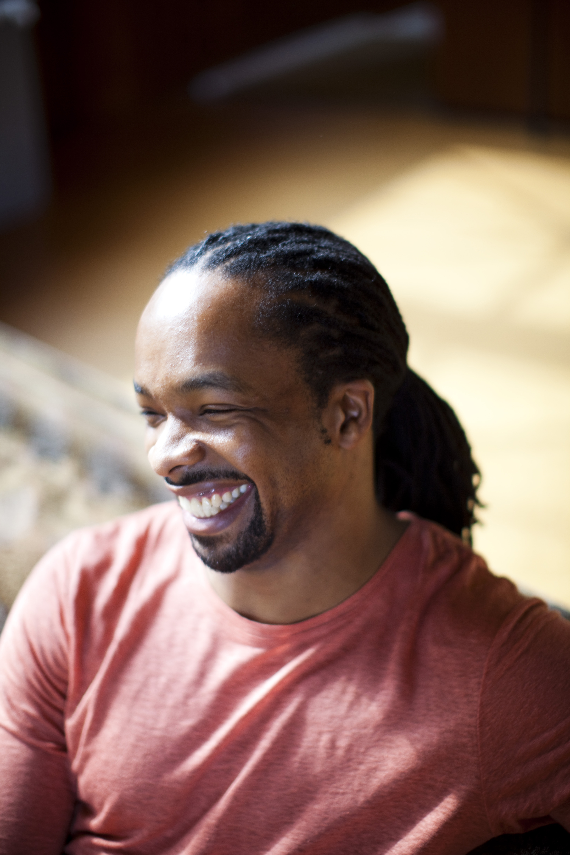
Komunyakaa, Yusef. Selected Poems. Or Brown, Jericho. Selected Poems.
I am leaning toward Komunyakaa. I may give choice to Brown. I love Komunyakaa’s work in its horrifically beautiful depictions of the Vietnam War and PTSD. I also love his works that pull on mythology—especially his Orpheus allusions. I can see his work linking well to other texts throughout the two years.
Brown also explores issues of power—especially in regard to being a homosexual black male. He is a fresh voice with an ATL connection.
Notes:
Komunyakaa PRL not Brown

Slide 58
Komunyakaa or Brown
Areas of Exploration
Readers, Writers, and Texts
How and why do we study literature?
How are we affected by literary texts in various ways?
In what ways is meaning constructed, negotiated, expressed and interpreted?
How do literary texts offer insights and challenges?
Time and Space
How does language represent social distinctions and identities?
Intertextuality
How do literary texts adhere to and deviate from conventions associated with literary forms?
In what ways can comparison and interpretation be transformative?
How can literary texts offer multiple perspectives of a single issue, topic or theme?
In what ways can diverse literary texts share points of similarity?
Concepts
Identity, creativity, communication, perspective, representation, and transformation
Fields of Inquiry for Global Issues:
Culture, identity, and community
Beliefs, values, and education
Art, creativity, and imagination
Politics, power, and justice
Science, technology, and the environment

Slide 59
Jin, Ha. Waiting. Or Que Mai, Nguyen Phan. The Mountains Sing.
The first is a great depiction of the cultural norms and political oppression of China in the later 20th Century in guise of a complicated love story.
The second centers on the political and social oppression of Vietnam before, during, and after the Vietnam War. It is told from the North Vietnamese point-of-view.
Notes:
Jin PRL not

Slide 60
Jin or Que Mai
Areas of Exploration
Readers, Writers, and Texts
In what ways is meaning constructed, negotiated, expressed, and interpreted?
How do literary texts offer insights and challenges?
Time and Space
How important is cultural or historical context to the production and reception of a literary text?
To what extent do literary texts offer insight into another culture?
How do literary texts reflect, represent or form a part of cultural practices?
Intertextuality
How do literary texts adhere to and deviate from conventions associated with literary forms?
In what ways can diverse literary texts share points of similarity?
How can literary texts offer multiple perspectives of a single issue, topic or theme?
In what ways can comparison and interpretation be transformative?
Concepts
Identity, culture, communication, perspective, and representation
Fields of Inquiry for Global Issues:
Culture, identity, and community
Beliefs, values, and education
Art, creativity, and imagination
Politics, power, and justice
Science, Technology, and the Environment

Slide 61
These Reflect Choices as Well
Males: 10//Females: 5 (I need more female authors)
Continents: North America, South America, Europe, Asia
Periods: 3 Pre 20th, 5 20th, 7 21st
PRL: 10
Works in Translation: 5 (Possibly 6)

Slide 62
On Hold

Slide 63
Marquez, Gabriel Garcia. Collected Novellas.
Marquez is an easy choice. Chronicle of a Death Foretold will pair well with In Cold Blood. I am planning on giving a choice to students of the other novella. These are classic novellas that allow us to explore magical realism and socio-politics.
Notes:
PRL

Slide 64
Marquez, Gabriel Garcia. Collected Novellas.
Areas of Exploration
Readers, Writers, and Texts
In what ways is meaning constructed, negotiated, expressed, and interpreted?
How does the structure or style of a literary text affect meaning?
How do literary texts offer insights and challenges?
Time and Space
How do we approach literary texts from different times and cultures to our own?
To what extent do literary texts offer insight into another culture?
How do literary texts reflect, represent or form a part of cultural practices?
How does language represent social distinctions and identities?
Intertextuality
How do literary texts adhere to and deviate from conventions associated with literary forms?
In what ways can comparison and interpretation be transformative?
Concepts
Identity, culture, creativity, communication, perspective, and representation
Fields of Inquiry for Global Issues:
Culture, identity, and community
Beliefs, values, and education
Art, creativity, and imagination
Politics, power, and justice
Science, technology, and the environment

Slide 65
Contact Information

Slide 66
Contact Information
Ms. Keeler
404-409-1114 by text (Please do not text me at midnight)
keelerjacksonhs@gmail.com (This is my preferred email)
jkeeler@apsk12.org
Please feel free to contact me with questions, concerns, or comments at the above. I can usually respond via text in a few minutes. I may respond with a meme.
Official Tutorial Day: Tuesdays 3:45-4:45

Slide 67
My Schedule

